Slide 1

Lecture 10.3 – Parallel Computation Patterns (scan)
GPU Teaching Kit
Accelerated Computing
A Work-Efficient Parallel Scan Kernel

Slide 2
Objective
To learn to write a work-efficient scan kernel
Two-phased balanced tree traversal
Aggressive re-use of intermediate results
Reducing control divergence with more complex thread index to data index mapping

Slide 3
Improving Efficiency
Balanced Trees
Form a balanced binary tree on the input data and sweep it to and from the root
Tree is not an actual data structure, but a concept to determine what each thread does at each step
For scan:
Traverse down from leaves to the root building partial sums at internal nodes in the tree
The root holds the sum of all leaves
Traverse back up the tree building the output from the partial sums

Slide 4
Parallel Scan - Reduction Phase
x₀
x₁
x₂
x₃
x₄
x₅
x₆
x₇
+
+
+
+
Time
∑x_{0..}x₁
∑x_{2..}x₃
∑x_{4..}x₅
∑x_{6..}x₇
+
+
∑x_{0..}x₃
∑x_{4..}x₇
+
In-place calculation
∑x_{0..}x₇
Value after reduce

Slide 5
Reduction Phase Kernel Code
// XY[2*BLOCK_SIZE] is in shared memory
for (unsigned int stride = 1;stride <= BLOCK_SIZE; stride *= 2) {
int index = (threadIdx.x+1)*stride*2 - 1;
if(index < 2*BLOCK_SIZE)
XY[index] += XY[index-stride];
__syncthreads();
}
threadIdx.x+1 = 1, 2, 3, 4….
stride = 1,
index = 1, 3, 5, 7, …

Slide 6
Parallel Scan - Post Reduction Reverse Phase
x₀
∑x_{0..}x₁
x₂
∑x_{0..}x₃
x₄
∑x_{4..}x₅
x₆
∑x_{0..}x₇
+
∑x_{0..}x₅
Move (add) a critical value to a central location where it is needed

Slide 7
Parallel Scan - Post Reduction Reverse Phase
x₀
∑x0..x1
x₂
∑x0..x3
x₄
∑x4..x5
x₆
∑x0..x7
+
∑x0..x5
+
+
+
∑x_{0..}x₂
∑x_{0..}x₄
∑x_{0..}x₆

Slide 8
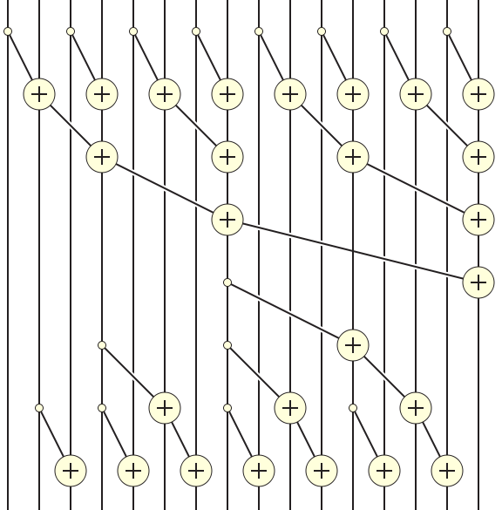
Putting it Together

Slide 9
Post Reduction Reverse Phase Kernel Code
for (unsigned int stride = BLOCK_SIZE/2; stride > 0; stride /= 2) {
__syncthreads();
int index = (threadIdx.x+1)*stride*2 - 1;
if(index+stride < 2*BLOCK_SIZE) {
XY[index + stride] += XY[index];
}
}
__syncthreads();
if (i < InputSize) Y[i] = XY[threadIdx.x];
First iteration for 16-element section
threadIdx.x = 0
stride = BLOCK_SIZE/2 = 8/2 = 4
index = 8-1 = 7

Slide 10
GPU Teaching Kit
The GPU Teaching Kit is licensed by NVIDIA and the University of Illinois under the Creative Commons Attribution-NonCommercial 4.0 International License.

